Slide 1
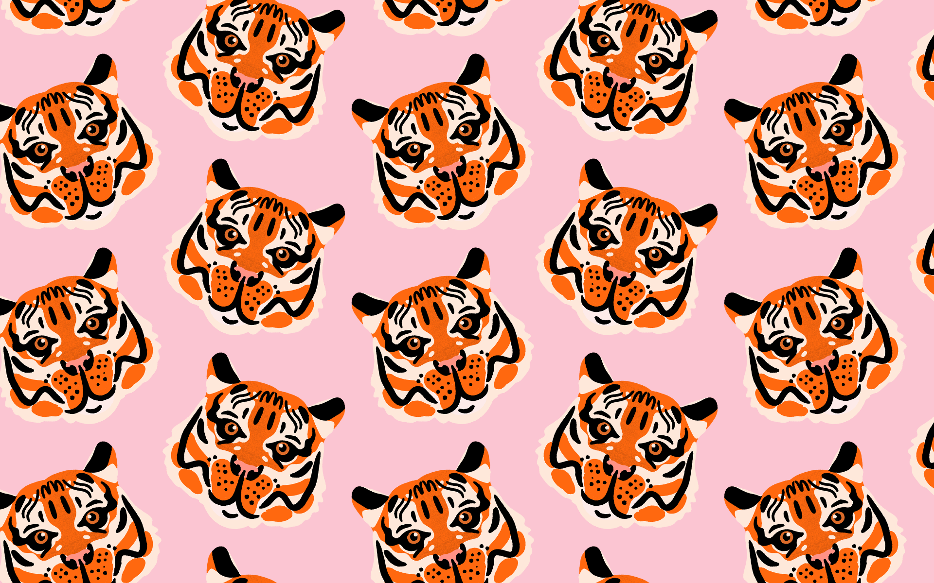
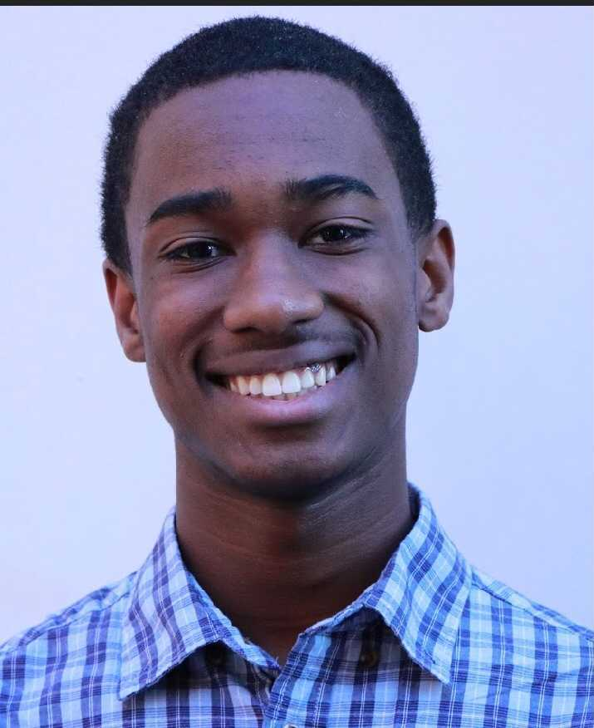
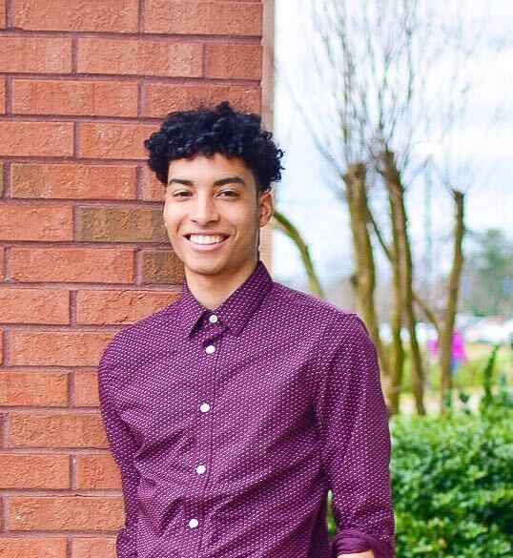
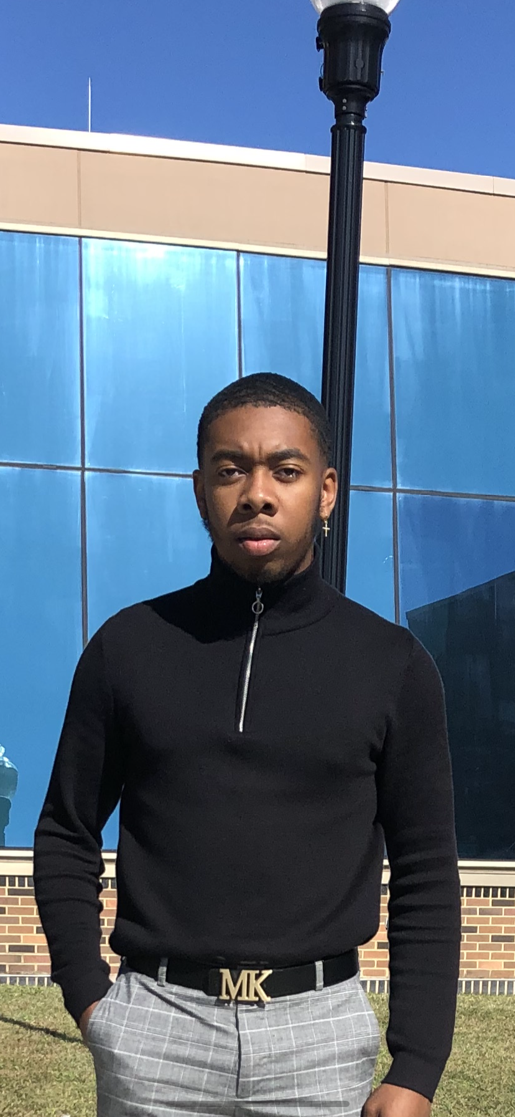
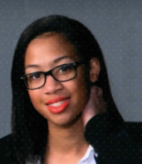
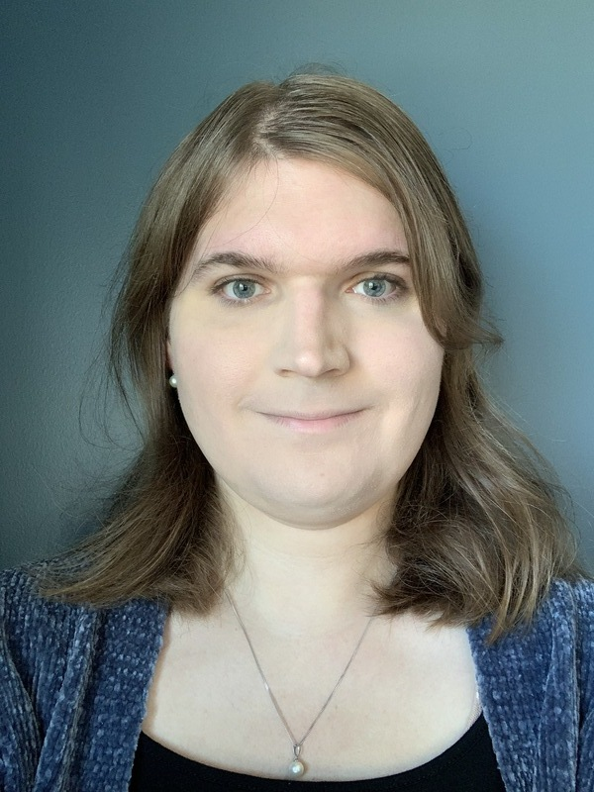
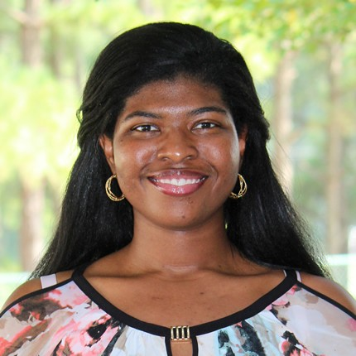

Rosadas Tigers: Modelling for Fighting!
Elijah Higgs
Team Member
Javier Guillén
Team Member
Demetrius Nicholson
Team Member
Rayna Wynn
Team Member
Mary Brandenburg Staff Team Member
JerNettie Burney
Mentor Team Member

